Slide 1
ITIL
Information Technology Infrastructure Library

Slide 2
CONTENTS OF THIS TEMPLATE
You can delete this slide when you’re done editing the presentation
FONTS | To view this template correctly in PowerPoint, download and install the fonts we used
USED AND ALTERNATIVE RESOURCES | An assortment of graphic resources that are suitable for use in this presentation
THANKS SLIDE | You must keep it so that proper credits for our design are given
COLORS | All the colors used in this presentation
ICONS AND INFOGRAPHIC RESOURCES | These can be used in the template, and their size and color can be edited
EDITABLE PRESENTATION THEME | You can edit the master slides easily. For more info, click here
For more info:
Slidesgo | Blog | FAQs
You can visit our sister projects:
Freepik | Flaticon | Storyset | Wepik | Videvo

Slide 3
TABLE OF CONTENTS
01
02
03
04
05
06
INTRODUCTION
PROBLEM & SOLUTION
MARKET OPPORTUNITY
PRODUCT DEMO
TEAM & TIMELINE
FINANCIAL & METRICS

Slide 4

WHAT IS ITIL?
ITIL is a library of best practices for managing and supporting IT functions within an organization.
The five key stages of ITIL
  Service Strategy
  Service Design
  Service Transition
  Service Operation
  Continual Service Improvement
Each of these stages contain processes and best practices to more effectively run and manage IT operations.

Slide 5
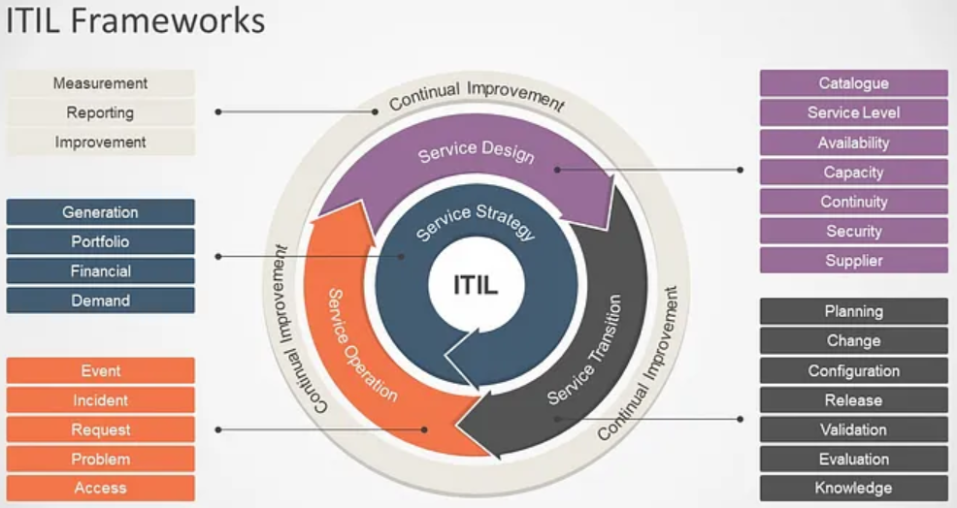

Slide 6
Service Strategy
Service Portfolio Management
Demand Management
Defines and documents IT services.
Provides projections for the demand of IT services so that we may better allocate resources.

Slide 7
Service Design
Availability Management
Service Level Management
Defines how me manage and monitor IT services.
Manages the creation and feedback processes for SLAs.

Slide 8
Service Transition
Change Management
Knowledge Management
Monitor the performance impact of a change in IT services.
Documentation that supports IT services.

Slide 9
Service Operation
Incident Management
Problem Management
How we resolve an individual disruption of an IT service.
How we resolve multiple related incidents – getting to root cause of the problem.

Slide 10
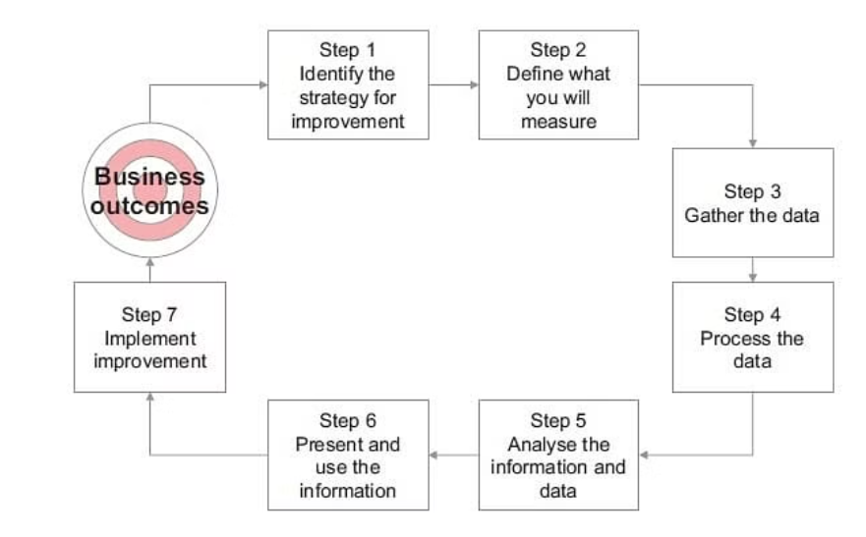
CSI – Continual Service Improvement

Slide 11
333,000
9h 55m 23s
386,000 km
Users bought our product
Estimated delivery time per unit
Avg. distance travelled by logistics team

Slide 12
4,498,300,000
Number of users analyzed in our market research

Slide 13
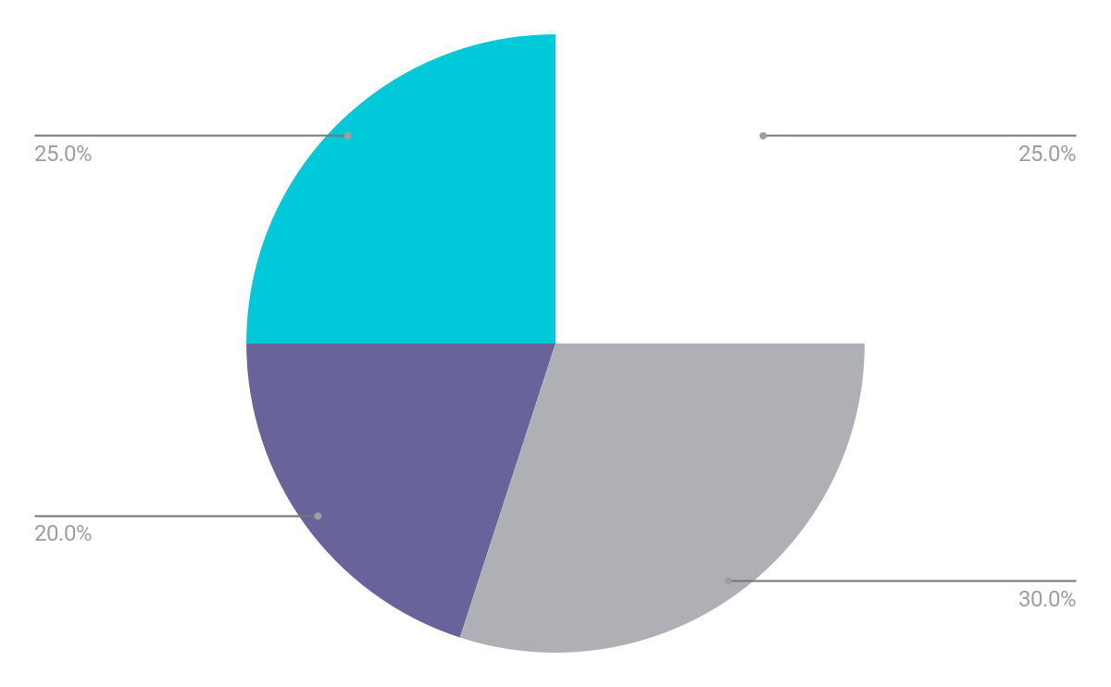
REVENUE BY QUARTER
Q1
Q2
Q3
Q4
January - March
April - June
July - September
October - December
Follow the link in the graph to modify its data and then paste the new one here. For more info, click here

Slide 14
COMPETITION COMPARISON
 | FEATURES | VALUE | PRICING | TRIAL | COMPETENCE | SHARE
Company A | Fuel economy | Special offers | $23,000 | No | Low | 8%
Company B | Design | Reliability | $27,000 | No | Low | 5%
Company C | Performance | Repairs | $30,000 | Yes | High | 20%
Company D | Safety features | Marketing | $24,000 | No | High | 22%
Company E | Technology | Customers | $32,000 | Yes | Low | 10%
Company F | Comfort | Best prices | $15,000 | Yes | High | 30%
Company G | Customization | Brand name | $45,000 | No | Low | 5%

Slide 15

PRODUCT INFOGRAPHIC
VISUALS
FEATURES
Showcase the design of your product
What makes your product unique?
PRICE
USERS
Share the cost and price with investors
Speak about the target audience
AVAILABILITY
UPDATES
When will the product be ready?
Do you plan on updating it?

Slide 16
TIMELINE OF YOUR PRESENTATION
Provide a brief overview of the pitch deck's content
Engage the audience with a compelling introduction
Identify the customer's pain points
and challenges
Describe how your product or service can solve the problem
Highlight the unique value proposition and benefits of your specific solution
Analyze the target market size, growth potential, and competition briefly
Explain your financial needs and briefly outline your
funding allocation
End with a clear and concise call to action

Slide 17
ORGANIZATIONAL CHART
Jane Doe
CEO
John Smith
Department Head
Maya Willson
Department Head
Emma Miller
Manager
Richard Taylor
Manager
Sarah Williams
Manager
Steven Ander
Manager
Brian Clark
Employee
Michelle García
Employee
James Scott
Employee
William Young
Employee
Alan Turner
Employee

Slide 18
MARKET SIZE OVERVIEW
OUTER CIRCLE
$100M
Include the total size of the market, which represents the entire potential customer base for the product or service
$20M
MIDDLE CIRCLE
Identify the target market for the product or service, which may be a subset of the total market. This could be based on factors such as demographics, geography, or specific needs
$5M
INNER CIRCLE
Indicate the current market size, which represents the portion of the target market that the company has successfully captured

Slide 19
ROADMAP INFOGRAPHIC
INITIATIVE | OBJECTIVE | JAN | FEB | MAR | APR | MAY | JUN | JUL | AUG | SEP | OCT | NOV | DEC
Understanding | Analyze and understand the needs of your target audience
Conduct research | Research existing products in the industry and analyze them
Brainstorm ideas | Generate ideas based on user feedback and research findings
Develop a prototype | Create a basic version of the product to show investors
Test for usability | Put the prototype through rigorous testing processes
Analyze feedback | Analyze feedback

Slide 20
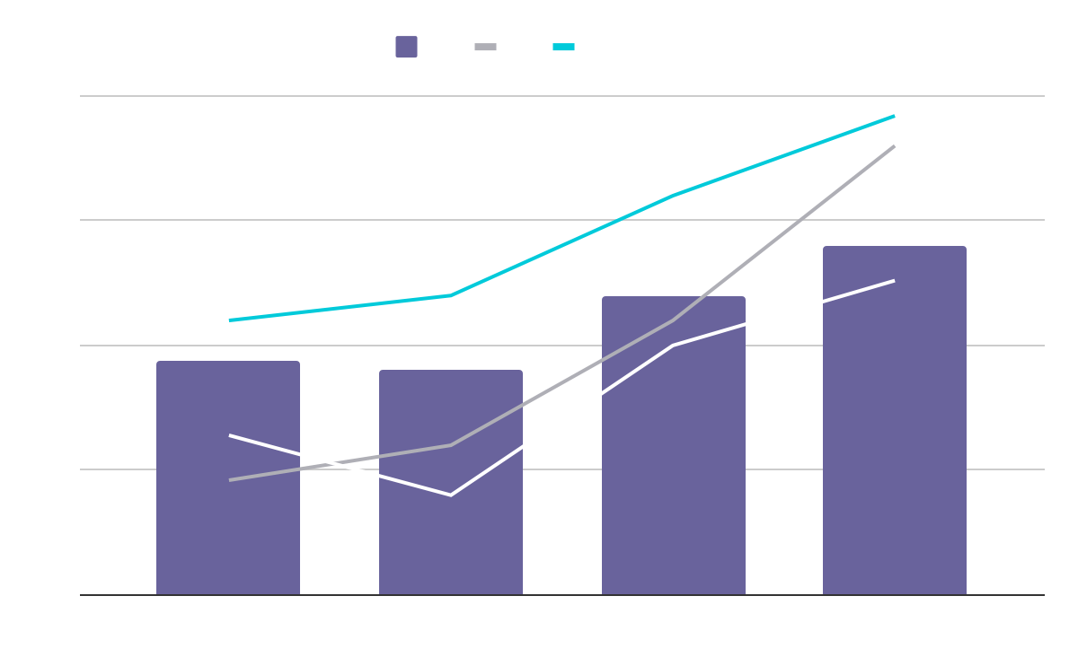
KPI DASHBOARD
PRODUCT | UNITS | REVENUE | RETURNS
Item 1 | 500 | 2,000,000 | 40
Item 2 | 1,000 | 50,750 | 10
Item 3 | 250 | 1,500,000 | 300
Item 4 | 500 | 2,000,000 | 40
Item 5 | 1,000 | 50,750 | 10
Item 6 | 250 | 1,500,000 | 300
Item 7 | 500 | 2,000,000 | 40
Item 8 | 1,000 | 50,750 | 10
$4,000,000
$100,000
$5,000
Revenue
General costs
Benefit
Follow the link in the graph to modify its data and then paste the new one here. For more info, click here

Slide 21
THANKS!
Do you have any questions?
youremail@freepik.com
+34 654 321 432
yourwebsite.com
Please keep this slide for attribution

Slide 22
ICON PACK

Slide 23
ALTERNATIVE RESOURCES
Here’s an assortment of alternative resources whose style fits the one of this template:
White technology design for wallpaper
Gradient cyber futuristic background

Slide 24
RESOURCES
Did you like the resources on this template? Get them for free at our other websites:
VECTORS
Artificial intelligence concept twitter header
Artificial intelligence concept youtube thumbnail
PHOTOS
Woman wearing virtual reality simulator
Medium shot woman holding smartphone
ICONS
Icon Pack: Innovation | Lineal

Slide 25
Instructions for use
If you have a free account, in order to use this template, you must credit Slidesgo by keeping the Thanks slide. Please refer to the next slide to read the instructions for premium users.
As a Free user, you are allowed to:
Modify this template.
Use it for both personal and commercial projects.
You are not allowed to:
Sublicense, sell or rent any of Slidesgo Content (or a modified version of Slidesgo Content).
Distribute Slidesgo Content unless it has been expressly authorized by Slidesgo.
Include Slidesgo Content in an online or offline database or file.
Offer Slidesgo templates (or modified versions of Slidesgo templates) for download.
Acquire the copyright of Slidesgo Content.
For more information about editing slides, please read our FAQs or visit our blog:
https://slidesgo.com/faqs and https://slidesgo.com/slidesgo-school

Slide 26
Instructions for use (premium users)
As a Premium user, you can use this template without attributing Slidesgo or keeping the Thanks slide.
You are allowed to:
Modify this template.
Use it for both personal and commercial purposes.
Hide or delete the “Thanks” slide and the mention to Slidesgo in the credits.
Share this template in an editable format with people who are not part of your team.
You are not allowed to:
Sublicense, sell or rent this Slidesgo Template (or a modified version of this Slidesgo Template).
Distribute this Slidesgo Template (or a modified version of this Slidesgo Template) or include it in a database or in any other product or service that offers downloadable images, icons or presentations that may be subject to distribution or resale.
Use any of the elements that are part of this Slidesgo Template in an isolated and separated way from this Template.
Register any of the elements that are part of this template as a trademark or logo, or register it as a work in an intellectual property registry or similar.
For more information about editing slides, please read our FAQs or visit our blog:
https://slidesgo.com/faqs and https://slidesgo.com/slidesgo-school

Slide 27
Fonts & colors used
This presentation has been made using the following fonts:
Raleway
(https://fonts.google.com/specimen/Raleway)
Hanken Grotesk
(https://fonts.google.com/specimen/Hanken+Grotesk)
#ffffff
#00cada
#110e24
#46406b
#69639c
#afafb6

Slide 28





Storyset
Create your Story with our illustrated concepts. Choose the style you like the most, edit its colors, pick the background and layers you want to show and bring them to life with the animator panel! It will boost your presentation. Check out how it works.
Pana
Amico
Bro
Rafiki
Cuate

Slide 29
Use our editable graphic resources...
You can easily resize these resources without losing quality. To change the color, just ungroup the resource and click on the object you want to change. Then, click on the paint bucket and select the color you want. Group the resource again when you’re done. You can also look for more infographics on Slidesgo.

Slide 32
JANUARY
FEBRUARY
MARCH
APRIL
MAY
JUNE
PHASE 1
Task 1
Task 2
PHASE 2
Task 1
Task 2
JANUARY
FEBRUARY
MARCH
APRIL
PHASE 1
Task 1
Task 2

Slide 35
...and our sets of editable icons
You can resize these icons without losing quality.
You can change the stroke and fill color; just select the icon and click on the paint bucket/pen.
In Google Slides, you can also use Flaticon’s extension, allowing you to customize and add even more icons.

Slide 36
Educational Icons
Medical Icons

Slide 37
Business Icons
Teamwork Icons

Slide 38
Help & Support Icons
Avatar Icons

Slide 39
Creative Process Icons
Performing Arts Icons

Slide 40
Nature Icons

Slide 41
SEO & Marketing Icons

Slide 42


